Slide 1
Prudential Group Insurance Product and system overview
July, 2013

Slide 2
System Descriptions
Link2GI:
Sales Customer Relationship Management system built on the Salesforce chassis. Link2GI begins the proposal process for all cases with greater than 1000 lives. We anticipate LINK2GI expanding to be the main system to facilitate the sales to customer relationship and be the sales portal for reporting and marketing campaigns.
Epiphany:
Sales Customer Relationship Management system. Epiphany begins the proposal process for all cases with less than 1000 lives and manages campaigns. We anticipate this system being sunset as LINK2GI moves down market.
Sales Prospecting and Request for Case Install (SPARC):
The SPARC platform serves 4 primary functions as Group Insurance’s policy issuance and administration system.
Provides small Market quotes and exhibits utilizing a proprietary rating engine, as well as an automated rules and workflow engine.
Serves as the installation vehicle for life and disability products. This includes additional data capture needed for sold cases, facilitation of the AOR process, and ultimately a feed to provide automated case set-up in our claims, billing, medical UW, and contract applications.
Provides a facility to capture ongoing changes to our inforce cases.
Facilitates enrollment setup and calculations

Slide 3
System Descriptions
Electronic Issue Brief (EIB):
EIB was the system of record for inforce cases prior to SPARC.
EIB is a mainframe application and is largely text based.
About 300 cases are still managed out of EIB
Group Integration Services (GIS):
GIS is the integration system between SPARC and all of the downstream systems
GIS takes a SPARC XML and translates it to the file format and language that is needed in each downstream system
COMPASS
Group: Is the primary billing application for group insurance. COMPASS enables case setup, monthly billing, premium payment application, case reconciliation's an application that sends and receives files from other applications within Group Insurance. Compass receives and processes information necessary for tracking and maintaining policy data including billing information. COMPASS is also the platform for Record Keeping Services cases.
OSGLI - Compass is a Web based application that sends and receives files from the VA. Compass receives and processes information necessary for tracking and maintaining policy data including billing information. Administration includes: Veteran setup, monthly billing, premium payment application, case reconciliation's. Compass support’s the OSGLI business group for the Veterans business (for both active and retired veterans).

Slide 4
System Descriptions
Life Claims Management System (LCMS):
LCMS is used by Group Life Claim Division (GLCD) to process and pay the group life insurance claims submitted by GI clients. Claim application is also used to manage the inbound and outbound communications including phone calls, scanned and faxed Images and correspondence letters.
Waiver of Premium division processes and manages reserve for the waiver claims received from GI’s LTD division and GI clients.
OSGLI division processes and pays claims submitted by the Office of Service Member Group Life Insurance.
Disability Claims Management System (DCMS)
Is an application that facilitates management of short term and long term disability claims and adjudicates disability claims. The application is primarily used to manage Disability and FMLA claims throughout their life cycle starting from claim intake, evaluation, management, processing disability payments and eventual claim termination. The system also supports Web based claim submission and client reporting
PRIDE:
Pride is the check writing system developed by Prudential Individual Life Insurance
Group insurance uses pride for all check writing needs
Oracle Ledger:
Is the Corporate Ledger system which all business units feed into
6 systems and 60+ manual processes feed the ledger
GIDW: Group Insurance Data Warehouse
Contracts Workflow Data System (CWDS):
The Contracts Systems is primarily responsible for generating Contracts for the Life and Disability Insurance. This system also supports LTC for generating its documentation. CWDS is basically made up of 2 systems CWDS which controls the front end and workflow and Calligo which generates the document
LINX: GUL/GVUL System
CITS:

Slide 5
System Descriptions
Group Insurance Data Warehouse (GIDW):
GIDW application focuses on the creation of a Transaction Database (TDB) for the analysis of premium , related claims and claim payment information for all of the products Group Insurance (GI) offers its clients.
Providing GI analysts with a view of clients, premiums, fees and claims, the database must contain data that capturing the beginning of the revenue & claim relationship.
The continued relationship is captured and measured via billing, accounts receivable, claims, payments, and reconciliation, and the end of the relationship (i.e., lapses). The GIDW is to provide a complete picture of all revenue, claims, adjustments and GI’s relationships with its clients, the Data Warehouse collects the historical data from 2000 thru present from the 15 source systems.
Contracts Workflow Data System (CWDS):
The Contracts Systems is primarily responsible for generating Contracts for the Life and Disability Insurance. This system also supports LTC for generating its documentation. CWDS is basically made up of 2 systems CWDS which controls the front end and workflow and Calligo which generates the document
LINX: GUL/GVUL System:
Linx provides administration functionality for the Group Universal and variable Universal Life Insurance products marketed and administered by Group LIfe and Disability. Provides Life Insurance with a cash accumulation option. Linx administers Eligibility, Coverage, COI, Interest, Medical Evidence, Access to Accounts, (withdrawals/loans), Paid up Insurance, Statements and Reporting, and Portability.

Slide 6
System Descriptions
E Commerce:
E Commerce is the high level grouping of systems which enable Group Insurance’s web interactions.
OSGLI Billing
OSGLI Claims
Employer Portal
Employee Portal
Medical Underwriting
Enrollment
Contracts
Life Claims submission
Disability Claim submission
CITS:
CITS is a multi-user database to which Underwriting manually inputs. Originally, the database was designed for Disability Underwriting workflow and case assignments. Including:
The storage of case, coverage, renewal and new issue functionality.
Application availability to users from Start Programs desktop toolbar.
Includes users from Underwriting, Actuarial, Client Experience Analysis, Claims, Contracts and Marketing.

Slide 7
System Descriptions
Content Management Workflow System (CMWS)
CMWS is a web-based workflow and imaging application that stores scanned and faxed images into a permanent repository as well as providing business unit specific workflow and case management capabilities for Prudential's Group Insurance businesses. Business users can display and modify stored images as well as move documents between queues based upon business rules provided. All data is held in Documentum.
Customer One:
Customer One is the current PEGA workflow implementation within group insurance. The overall goal is to create process based workflows will leverage business services that interface with the administration applications making the Process layer application agnostic. One of the key drivers of this implementation to span the workflow over multiple applications but track and report like a single workflow. Customer One is current used in the call center and OSGLI
Group Experience Analysis and Returns System (GEARS)
GEARS enables the calculation and reporting of the dividends for Participating Life business
Billing and Accounts Receivable Reconciliation System (BARRS)
BARRS is the monthly receivable financial statement reporting system. BARRS is used by the Premium Accounting team to set/post the monthly receivable for group insurance and other accounting duties. BARRS receives data from various systems to perform reconciliation activities.

Slide 8
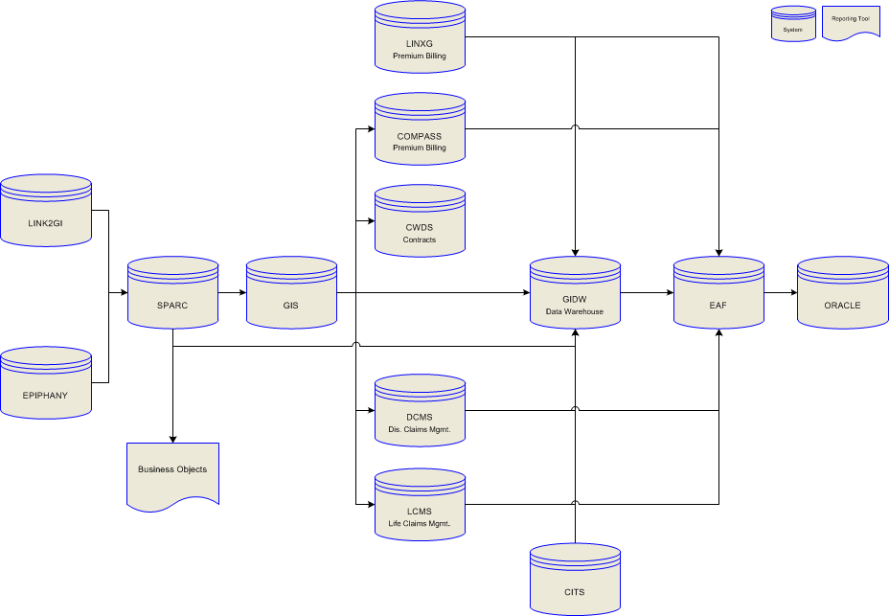
High Level System interactions

Slide 9
Features Applicable to All Insurance Products
Waiting Periods
Setup as a number of Hours worked , Days, Weeks, Months up to 1 year which define the amount of time an employee must be with an employer.
Waiting periods of greater than 1 year are eligibility definitions (see below)
Particularly relevant for enrollment and eligibility processing
Eligibility definition
Define the conditions that an employee must meet to qualify for insurance
The most common definition is All Employees
Definitions such as All Management, All Salaried and All Other are also common
Some groups especially unions can have very specific and lengthy definitions
Minimum hours
Defines the number of hours required to qualify for insurance
Earnings Definition
Defines the salary, bonus, commissions that will be used to calculate the insurance amount
Also defines the period of time that each amount will be calculated over
Not used for flat dollar benefits
Commissions
Defines the payments that will be made to a producer. Typically a flat percentage or level scale

Slide 10
Basic Life
What is Basic Life?
Basic Life is a product that pays a benefit to the employee’s beneficiary if the employee dies.
Basic Life is generally a non-contributory product that is paid for by the employer. I have never seen an enrollment where the employee had to pay for basic life, but we do support it.
During enrollment if the product is included it is displayed for informational purposes since the employer pays for the coverage and employees do not opt out of the coverage
Since the employer is paying for the coverage Basic Life only has 1 option for each person. So a typical Basic Life plan will be a flat 10,000 or 1X Earnings with a maximum of 50,000
Basic life rates are generally single rates that do not vary by age.

Slide 11
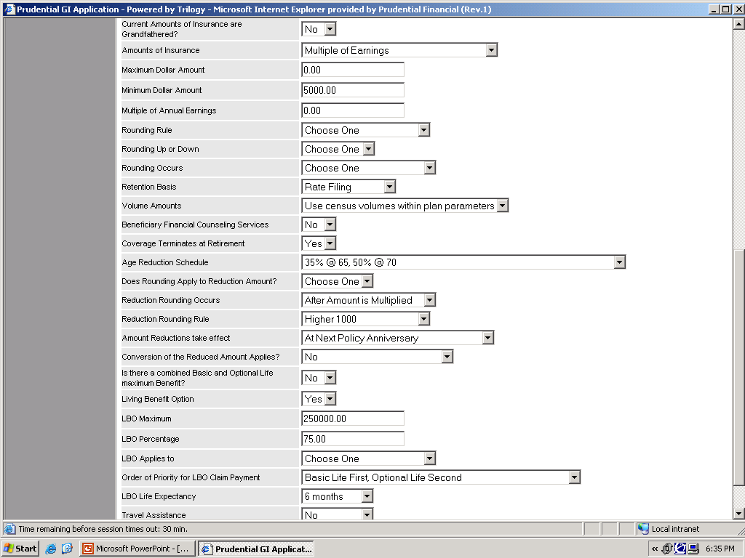
Amounts of Insurance Fields: Used to specify the basic insurance coverage
Rounding of Reduced Amount: Rarely used indicates how the reduced amount will be rounded. Basically a second round of rounding
Rounding Rule: Used to specify How the benefit will be rounded for billing and claim payment
Beneficiary Financial Counseling Services Field: Used to indicate that the plan has My Guidance Resources
Is their a Combined Basic and Optional Life Maximum: Indicates One Maximum coverage amount applies to both Basic and Optional Life.
Age Reduction Schedule: Indicates the Ages and percentages that benefit will be reduced. If this field = “Other” a custom reduction is being used. (demo later)
Living Benefit Option Fields: Indicate the conditions and amounts of life insurance that can be paid prior to Employee’s death. SPARC specifies a percentage, a maximum and a life expectancy
Notes:
Basic Life Plan Design

Slide 12
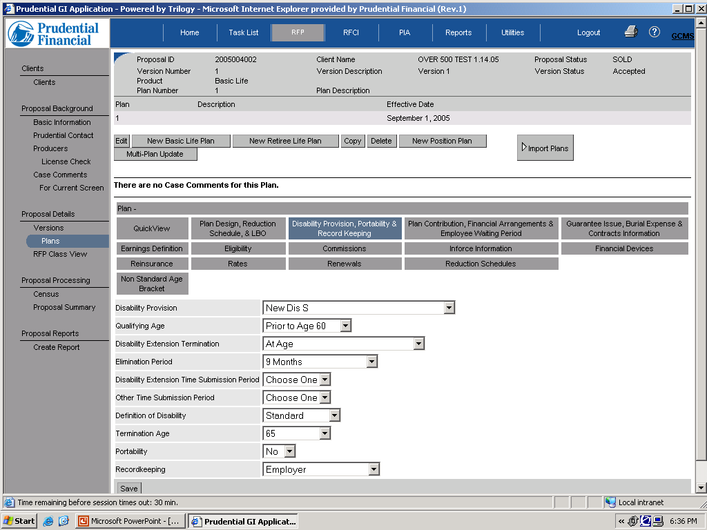
Disability Provision: Indicates the rules that will be used for Disabled Employees Most common selection is New Dis S and None
Qualifying Age: Indicates Age employee must be disabled before to have premium suspended
Elimination Period: Indicates length of time employee must be disabled before premium payments are suspended
Portability: A benefit allowing employees to keep Group Insurance Benefits after leaving their employer
Termination Age: indicates age that coverage will be terminated for disabled employees
Notes:
Dis S = A Group Insurance Benefit that suspends premium payments for employees disabled prior to age 60 and who are continously disabled for 9 months
Dis A=

Slide 13
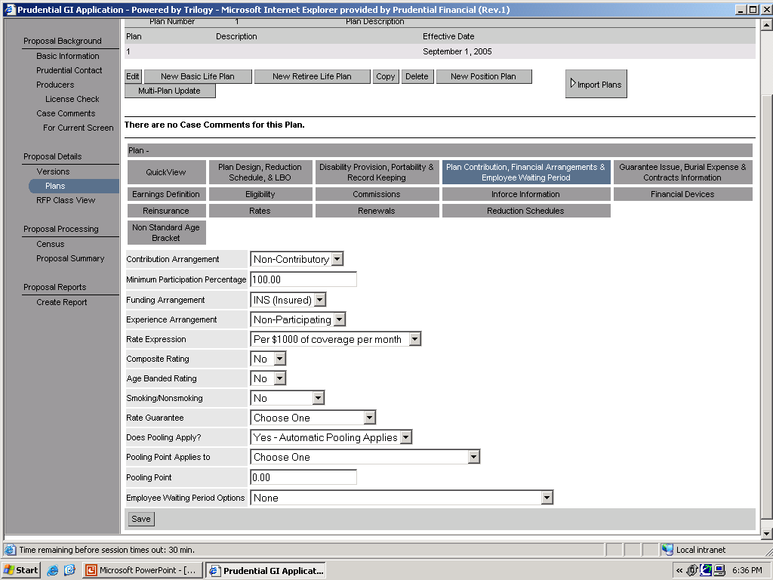
Minimum Participation Percentage: Indicates the percentage of eligible Employees expected to participate in the plan
Contribution Arrangement: Indicates who is paying for the insurance coverage Non-Contributory =Employer Paid
Contributory= Employee Paid
Rate Expression: Indicates the volume basis and period the rate will be billed on. In this case per 1000 of volume per month
Age Banded Rating: Indicates whether the rates are differentiated by age. Do not confuse this with the Composite rating field above which is not used for your cases
Smoking/NonSmoking: Indicates if the rates are different for employees who smoke and those who do not
Rate Guarantee: Indicates the amount of time that the rate for a particular product will stay in affect assuming the group continues to meet underwriting guidelines. This field along with the effective date are used to calculate the renewal date
Notes:
Basic life plan contribution

Slide 14
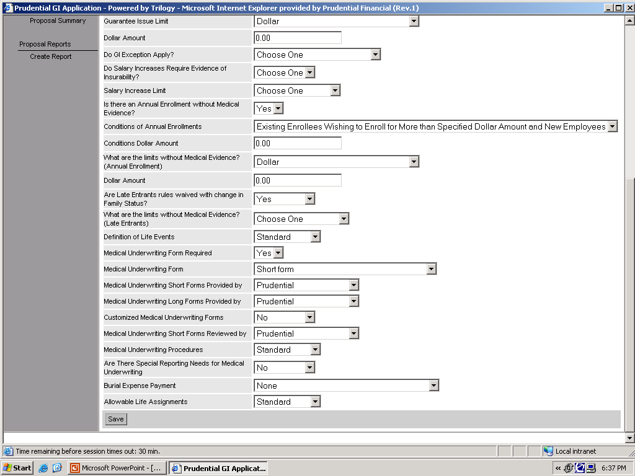
Medical Underwriting form: Indicates the type of evidence of insurability an employee needs to provide to enroll in insurance amounts over the Guarantee issue
Guarantee Issue: Indicates the amount of coverage an employee can receive without giving evidence of good health. Guarantee Issue can also be expressed as a combination of multiple of earnings and Dollar amount. The remainder of the page lays out exceptions and methods for applying the guarantee issue
Is their an annual enrollment without medical evidence: The Field indicates employees can re-enroll in the insurance coverage on an annual basis
Are Late entrant rules waived with change in family status: The Field indicates employees can re-enroll in the insurance coverage When they have certain life events such as the birth of a child or marriage
Notes:
Basic Life Guarantee Issue

Slide 15
Basic ADD
What is Basic ADD?
Basic Accidental Death and Dismemberment is a product that pays a benefit to the employee/the employee’s beneficiary if the employee is severely injured or dies in an accident.
Basic ADD is generally a non-contributory product that is paid for by the employer.
During enrollment if the product is included it is displayed for informational purposes since the employer pays for the coverage and employees do not opt out of the coverage
Since the employer is paying for the coverage Basic ADD only has 1 option for each person. So a typical Basic ADD plan will be a flat 10,000 or 1X Earnings with a maximum of 50,000
Basic ADD rates are always single rates that do not vary by age or whether the employee smokes or not I have never seen any other rate type. However, we do support age banded and smoker/non smoker ADD rates

Slide 16
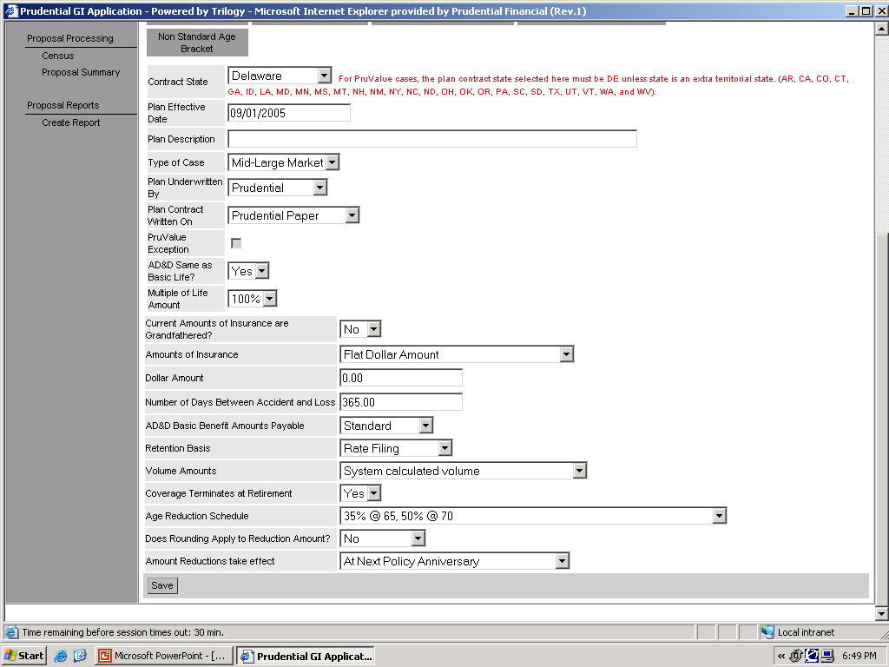
Plan Effective Date: Indicates the date the plan will go into affect
Amounts of Insurance Fields: Used to specify the basic insurance coverage
Age Reduction Schedule: Indicates the Ages and percentages that benefit will be reduced. If this field = “Other” a custom reduction is being used. (demo later)
Amount Reductions Take effect: Indicates the point in time that the age reduction will actually reduce the Employee Benefit
Notes:
Add plan design

Slide 17
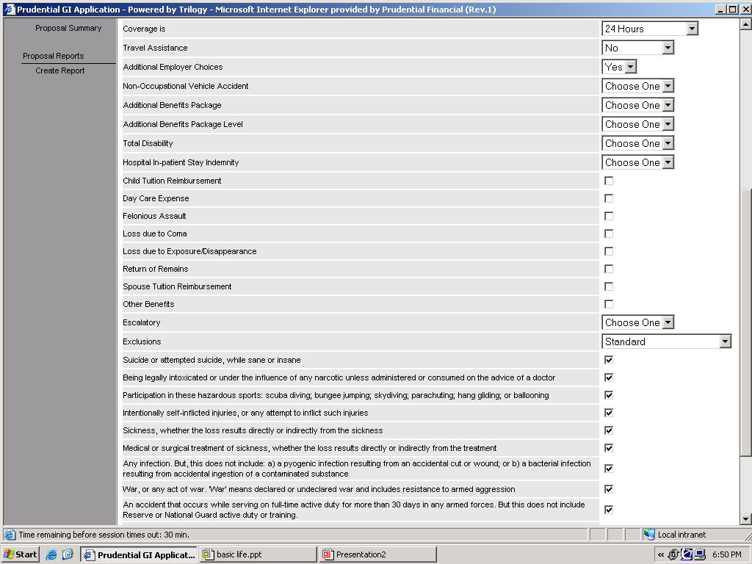
Coverage Is: Indicates the Type of coverage provided by an ADD or OADD plan. There are 3 options: 24 hour
Non Occupational
And Occupational
Additional Employer Choices: Selecting Yes in this field allows the user to select several optional benefits for ADD/OADD. If this field =No the additional benefits packages are not included
Exclusions: These fields indicate the items excluded from ADD/OADD coverage
Notes:
ADD additional benefits and choices

Slide 18
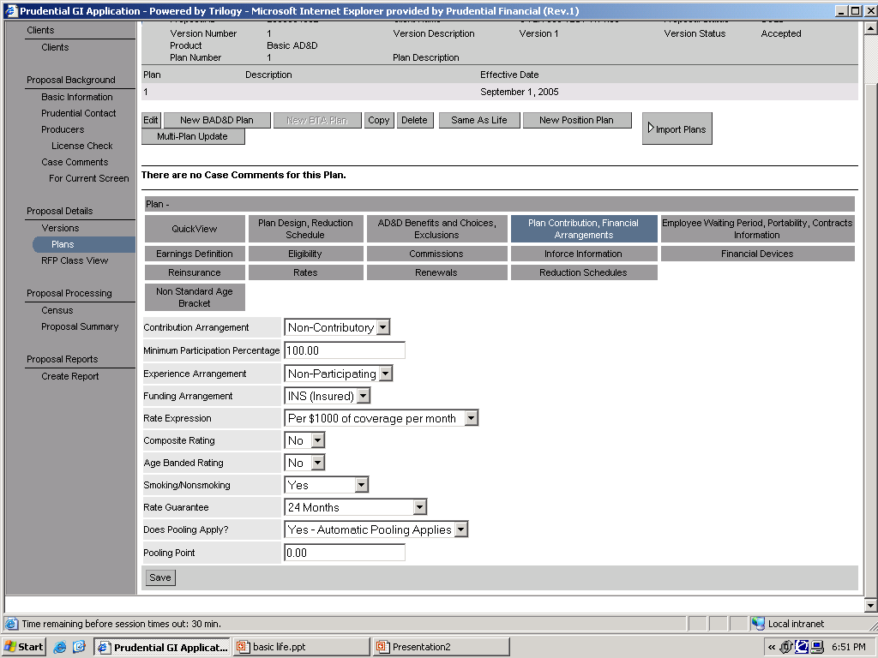
Contribution Arrangement: Indicates who is paying for the insurance coverage Non-Contributory =Employer Paid
Contributory= Employee Paid
Minimum Participation Percentage: Indicates the percentage of eligible Employees expected to participate in the plan
Rate Expression: Indicates the volume basis and period the rate will be billed on. In this case per 1000 of volume per month
Age Banded Rating: Indicates whether the rates are differentiated by age. Do not confuse this with the Composite rating field above which is not used for your cases
Smoking/NonSmoking: Indicates if the rates are different for employees who smoke and those who do not
Rate Guarantee: Indicates the amount of time that the rate for a particular product will stay in affect assuming the group continues to meet underwriting guidelines. This field along with the effective date are used to calculate the renewal date
Notes:
ADD plan contribution

Slide 19
Optional Life
What is Optional Life ?
Optional Life is a product that pays a benefit to the employee’s beneficiary if the employee dies.
Optional Life is generally a contributory product that is paid for by the employee if they choose to purchase it.
The optional life amounts of insurance are different from the basic life amounts of insurance in that they allow a choice of options. So rather than a flat dollar amount that allows 1 amount ex. Flat 10,000(Basic Life). Optional life will have an incremental flat amount that allows many options ex. 10,000-300,000 in increments of 10,000.
Optional Life is the most commonly enrolled product. 90+ Percent of enrollments will contain optional life.
Optional Life rates are almost always age banded

Slide 20
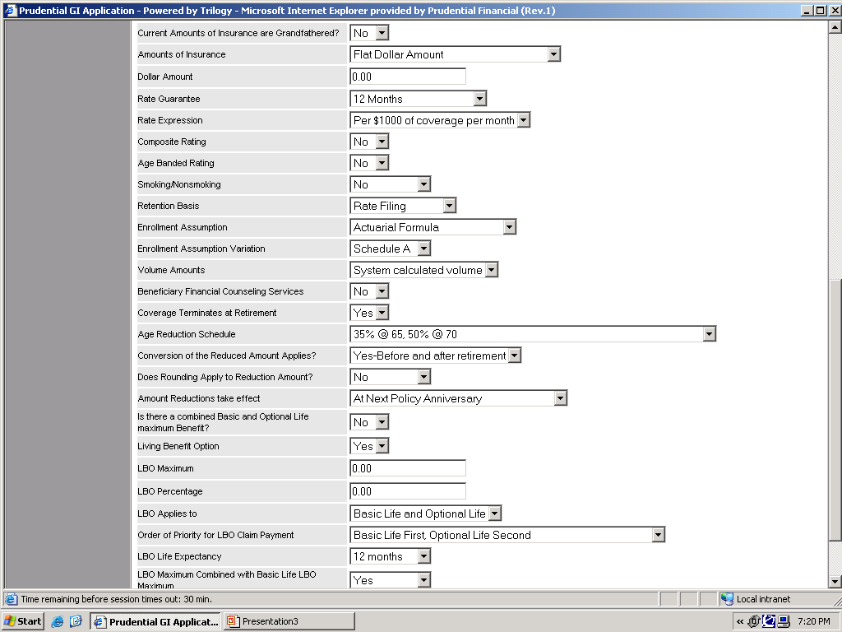
Amounts of Insurance Fields: Used to specify the basic insurance coverage
Rate Expression: Indicates the volume basis and period the rate will be billed on. In this case per 1000 of volume per month
Age Banded Rating: Indicates whether the rates are differentiated by age. Do not confuse this with the Composite rating field above which is not used for your cases
Beneficiary Financial Counseling Services Field: Used to indicate that the plan has My Guidance Resources
Age Reduction Schedule: Indicates the Ages and percentages that benefit will be reduced. If this field = “Other” a custom reduction is being used. (demo later)
Is their a Combined Basic and Optional Life Maximum: Indicates One Maximum coverage amount applies to both Basic and Optional Life.
Living Benefit Option Fields: Indicate the conditions and amounts of life insurance that can be paid prior to Employee’s death. SPARC specifies a percentage, a maximum and a life expectancy
Notes:
OGL plan design

Slide 21
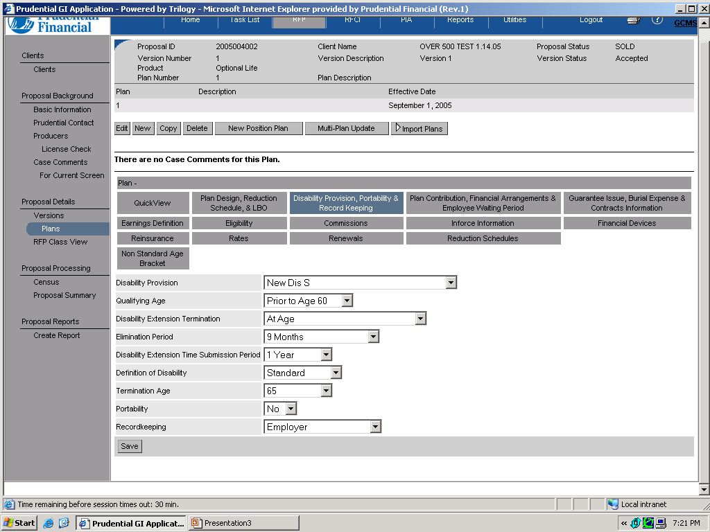
Disability Provision: Indicates the rules that will be used for Disabled Employees Most common selection is New Dis S and None
Qualifying Age: Indicates Age employee must be disabled before to have premium suspended
Elimination Period: Indicates length of time employee must be disabled before premium payments are suspended
Termination Age: indicates age that coverage will be terminated for disabled employees
Portability: A benefit allowing employees to keep Group Insurance Benefits after leaving their employer
Notes:
OGL disability provision

Slide 22
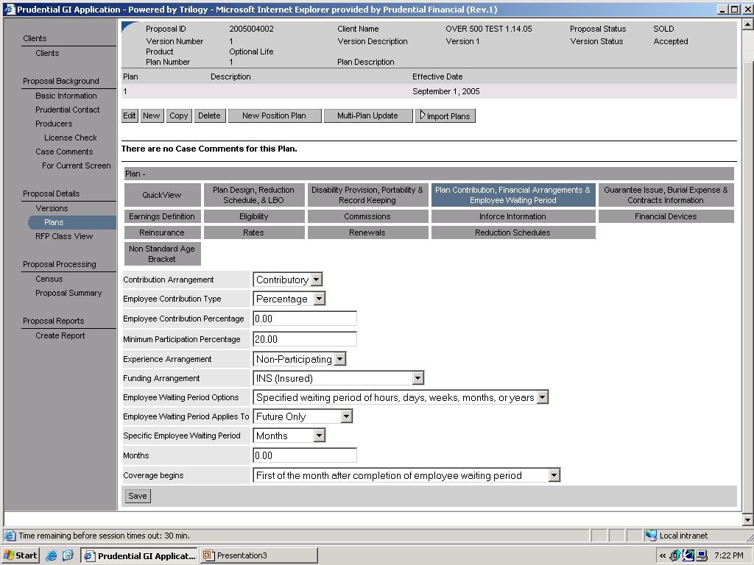
Contribution Arrangement: Indicates who is paying for the insurance coverage Non-Contributory =Employer Paid
Contributory= Employee Paid
Employee Contribution Percentage: The Percentage that the employee contributes towards the optional life premium
Minimum Participation Percentage: Indicates the percentage of eligible Employees expected to participate in the plan
Notes:
OGL plan contribution

Slide 23
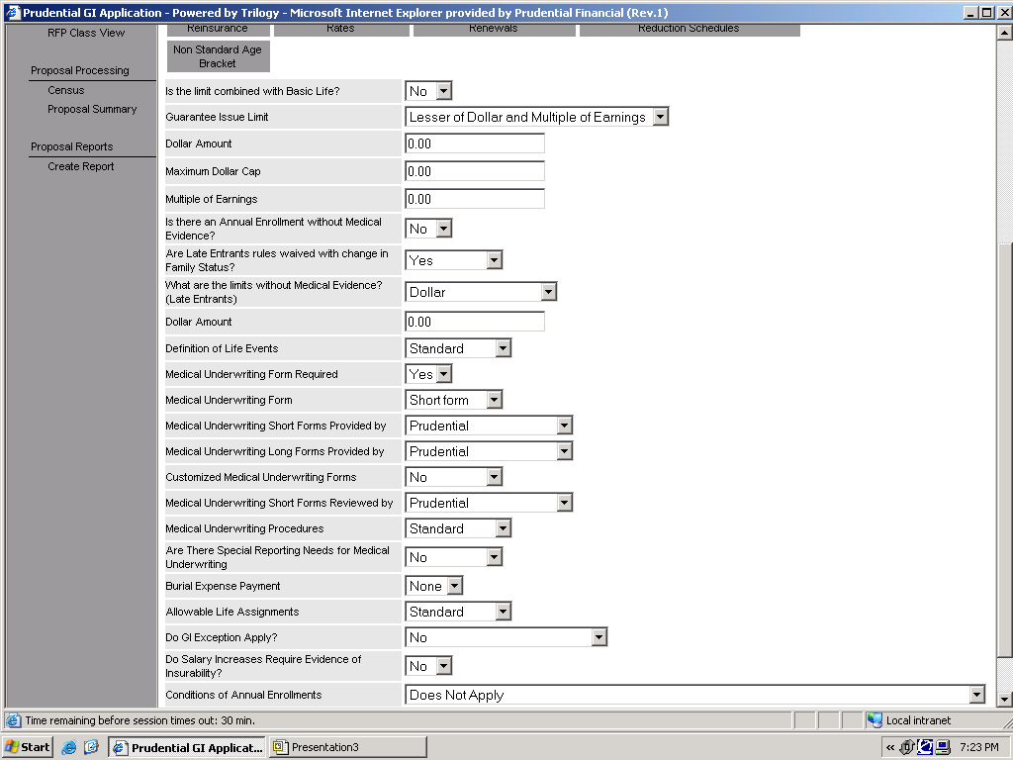
Is their an annual enrollment without medical evidence: The Field indicates employees can re-enroll in the insurance coverage on an annual basis
Guarantee Issue: Indicates the amount of coverage an employee can receive without giving evidence of good health. Guarantee Issue is expressed here as a combination of multiple of earnings and Dollar amount. The remainder of the page lays out exceptions and methods for applying the guarantee issue
Are Late entrant rules waived with change in family status: The Field indicates employees can re-enroll in the insurance coverage When they have certain life events such as the birth of a child or marriage
Medical Underwriting form: Indicates the type of evidence of insurability an employee needs to provide to enroll in insurance amounts over the Guarantee issue
Notes:
OGL GI

Slide 24
Optional ADD
What is Optional Accidental Death and Dismemberment (OADD)?
Optional ADD is a product that pays a benefit to the employee’s beneficiary if the employee dies or becomes severely injured.
Optional ADD is generally a contributory product that is paid for by the employee if they choose to purchase it.
The optional ADD amounts of insurance are different from the basic life amounts of insurance in that they allow a choice of options. So rather than a flat dollar amount that allows 1 amount ex. Flat 10,000(Basic Life). Optional life will have an incremental flat amount that allows many options ex. 10,000-300,000 in increments of 10,000.
Optional ADD rates are almost always single flat rates
Optional ADD is the most complicated life product because it is really 4 products in one. It can have Employee Coverage, Spouse coverage, Child Coverage or Family coverage in many different combinations depending on plan setup
In Addition to the many products OADD can be setup to match Optional life or not match Optional Life

Slide 25
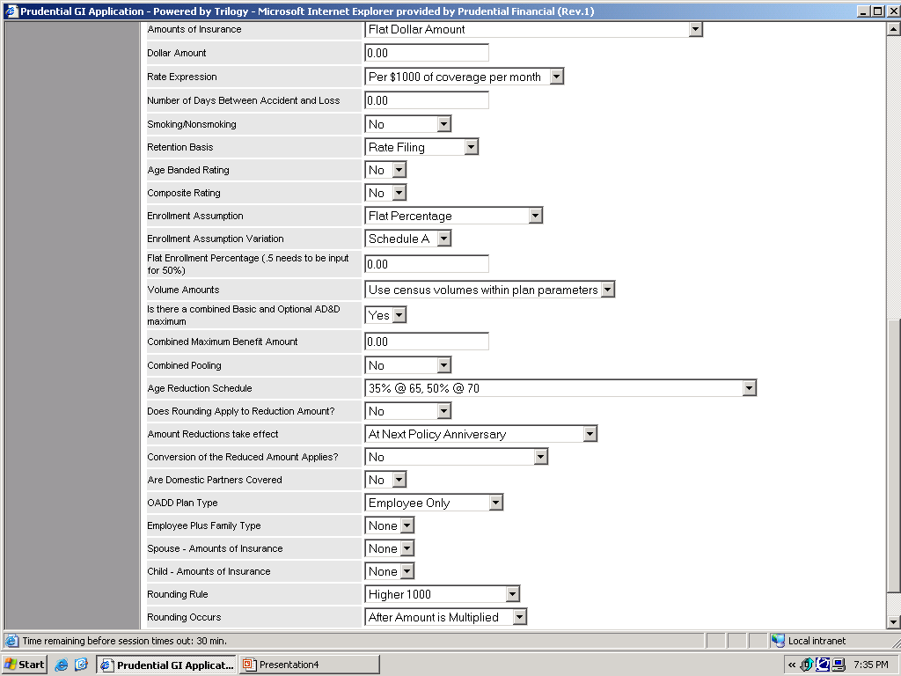
Amounts of Insurance Fields: Used to specify the basic insurance coverage
Age Reduction Schedule: Indicates the Ages and percentages that benefit will be reduced. If this field = “Other” a custom reduction is being used. (demo later)
Amount Reductions Take effect: Indicates the point in time that the age reduction will actually reduce the Employee Benefit
OADD Plan Type: Indicates whether plan covers Employees only or Employees and their families (demo later)
Notes:
OADD plan design

Slide 26
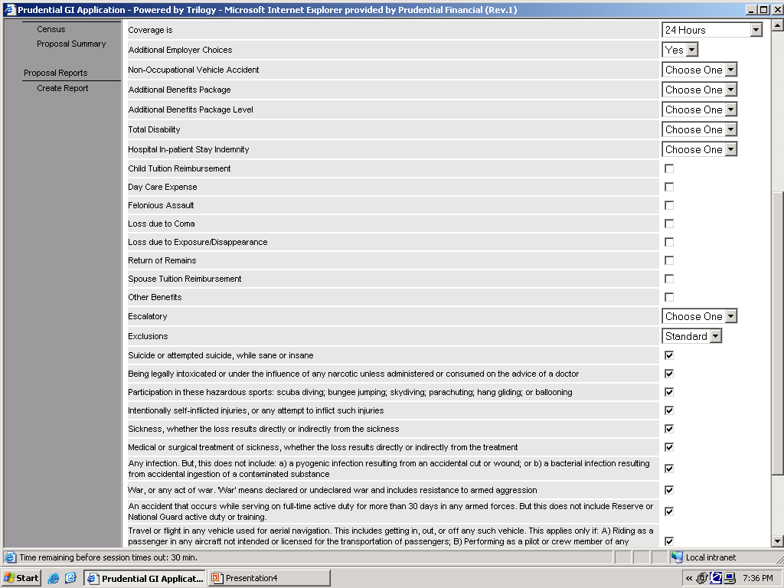
Coverage Is: Indicates the Type of coverage provided by an ADD or OADD plan. There are 3 options: 24 hour,
Non Occupational
and Occupational
Additional Employer Choices: Selecting Yes in this field allows the user to select several optional benefits for ADD/OADD. If this field =No the additional benefits packages are not included
Exclusions: These fields indicate the items excluded from ADD/OADD coverage
Notes:
OADD benefits and choices

Slide 27
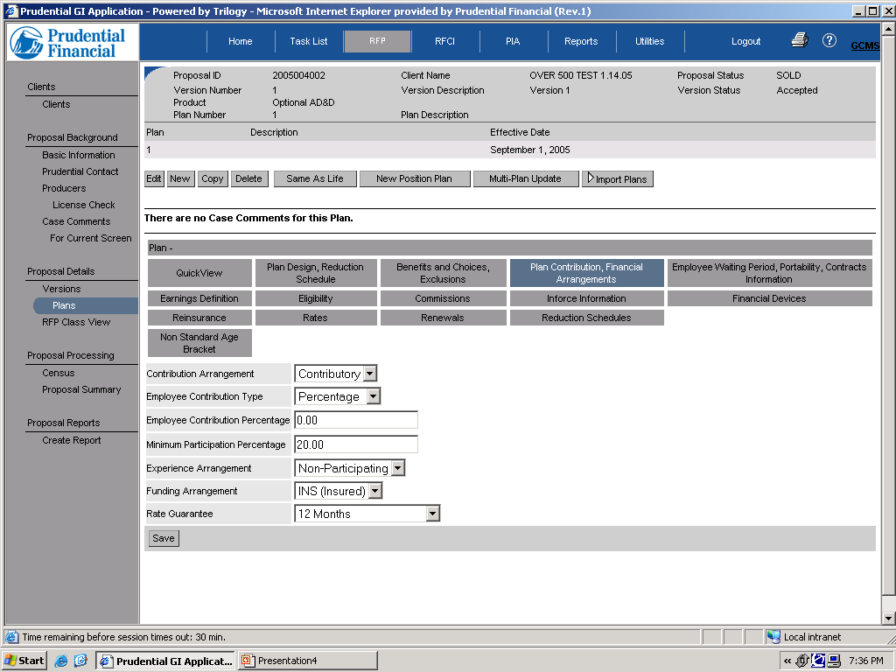
Contribution Arrangement: Indicates who is paying for the insurance coverage Non-Contributory =Employer Paid
Contributory= Employee Paid
Minimum Participation Percentage: Indicates the percentage of eligible Employees expected to participate in the plan
Notes:
OADD plan contribution

Slide 28
Dependent Life
What is Dependent Life?
Dependent Life is a product that pays a benefit to the employee’s beneficiary if the employee’s spouse/child dies.
Dependent Life can be either Contributory or Non Contributory. Contributory plans are called Optional Dependent Life and are created using the Optional Dependent Life button. Non Contributory plans are called Basic Dependent Life and are created using the Basic Dependent Life button.
Optional Dependent Life is the 2nd most commonly enrolled product after Optional Life
Dependent Life is different from most other products because there are 2 types of coverage Spouse Coverage and Child Coverage. So 1 product turns into 2 on the Web Enrollment site
The Like Optional Life Optional Dependent Life amounts of insurance are different from the basic life amounts of insurance in that they allow a choice of options. So rather than a flat dollar amount that allows 1 amount ex. Flat 10,000(Basic Life). Optional Dependent Life will have an incremental flat amount that allows many options ex. 10,000-300,000 in increments of 10,000.
There is a large amount of variation in Dependent life rates. They can be age banded, can have single rates for spouses/children or 1 rate for the entire family. In addition when the rate is age banded the actual rate calculation can be based on the Spouse’s age or the employee’s age.

Slide 29
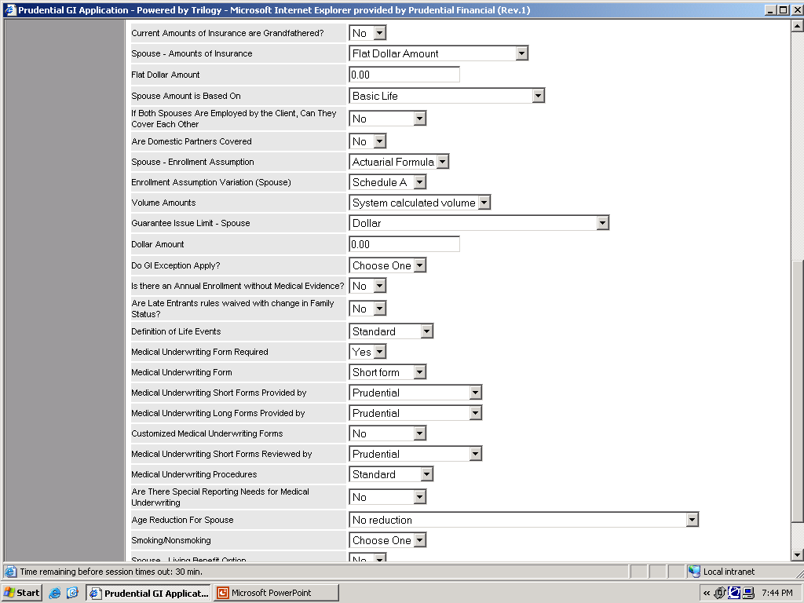
Amounts of Insurance Fields: Used to specify the basic insurance coverage
Guarantee Issue Limit Spouse: Indicates the amount of coverage an employee can receive without giving evidence of good health.
Is their an annual enrollment without medical evidence: The Field indicates employees can re-enroll in the insurance coverage on an annual basis
Medical Underwriting form: Indicates the type of evidence of insurability an employee needs to provide to enroll in insurance amounts over the Guarantee issue
Age Reduction Schedule: Indicates the Ages and percentages that benefit will be reduced. If this field = “Other” a custom reduction is being used. (demo later)
Notes:
DGL spouse

Slide 30
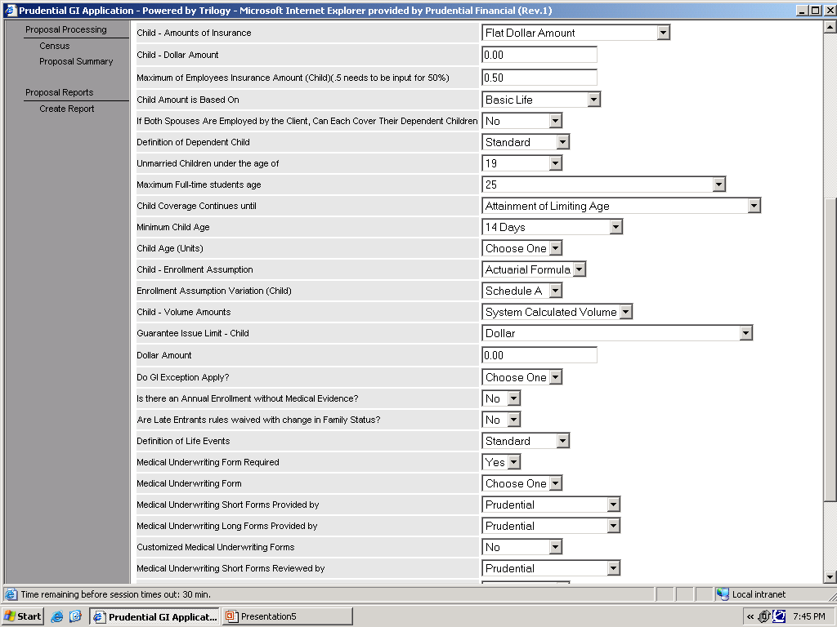
Maximum of employee’s Insurance Amount: The multiple of the employee coverage allowed for Child coverage. Typically 50%
Amounts of Insurance Fields: Used to specify the basic insurance coverage
Child Amount Based on: Indicates the product or products used to cap Child dependent life coverage
Unmarried Children Under the Age of and Maximum Full time student age: Indicate the maximum age for dependent life coverage
Child Minimum Age: Indicates the lowest age that child coverage can begin
Notes:
DGL child plan design

Slide 31
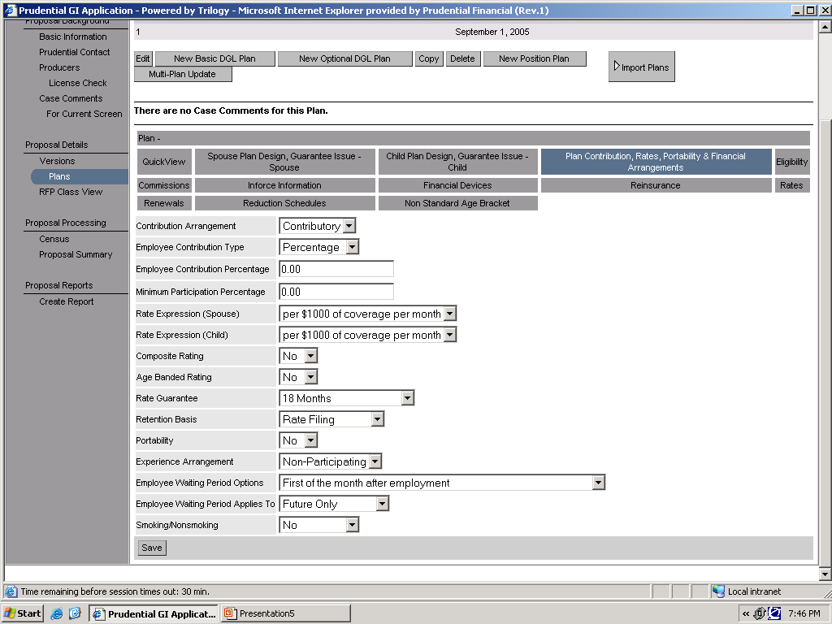
Contribution Arrangement: Indicates who is paying for the insurance coverage Non-Contributory =Employer Paid
Contributory= Employee Paid
Minimum Participation Percentage: Indicates the percentage of eligible Employees expected to participate in the plan
Rate Expression: Indicates the volume basis and period the rate will be billed on. In this case per 1000 of volume per month
Age Banded Rating: Indicates whether the rates are differentiated by age. Do not confuse this with the Composite rating field above which is not used for your cases
Notes:
DGL plan contribution

Slide 32
Short Term Disability
What is Short Term Disability (STD)?
STD is a disability product that pays the employee a benefit, usually a percentage of there earnings, if they become injured or sick and are out long enough.
STD only has 1 benefit amount either a percentage of the employee’s earnings or a flat dollar amount.
STD can be setup as contributory or non contributory or anything in between. Partially contributory plans are more common in the disability products
Most of the variables we will see affect Standard Register and do not impact the Web.
STD rates are usually single flat rates but can be age banded. I have not seen smoker non smoker rates

Slide 33
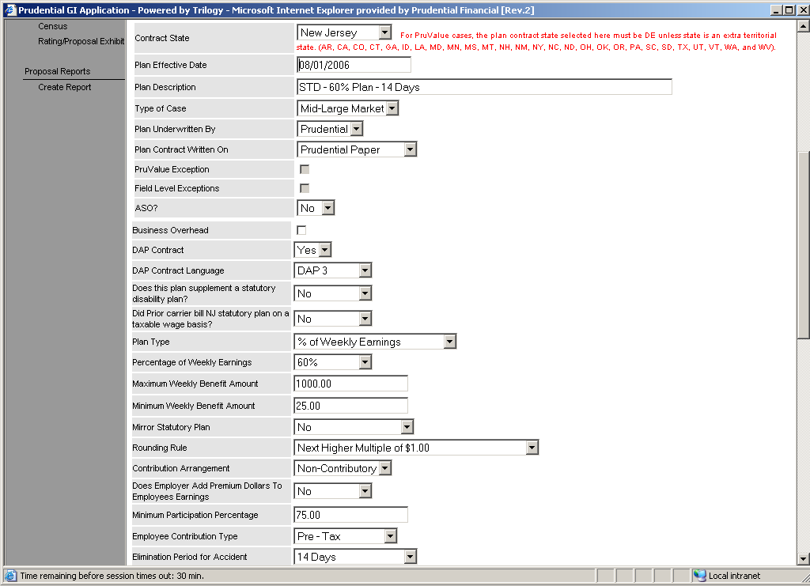
STD Plan Design 1
Plan Description Used to identify the plan
Plan Type: This field indicates how the STD benefit will be calculated either a Percentage of earnings or a flat amount
Minimum Weekly Benefit: After the weekly salary is multiplied by the benefit % we compare the benefit to the minimum and take the greater of the 2 numbers
Percentage of Weekly Earnings: this field is the number that will be multiplied by the weekly salary and then paid out as a benefit
Contribution Arrangement: This field indicates if the employer or the employee will pay for the coverage. Contributory Means the Employee Pays. Non Contributory means the employer pays
Maximum Dollar amount: After the weekly salary is multiplied by the benefit % we compare the benefit to the maximum and take the lesser of the 2 numbers
Elimination Period Accident: this is the amount of time an employee must be out of work due to an accident before they start receiving STD payments

Slide 34
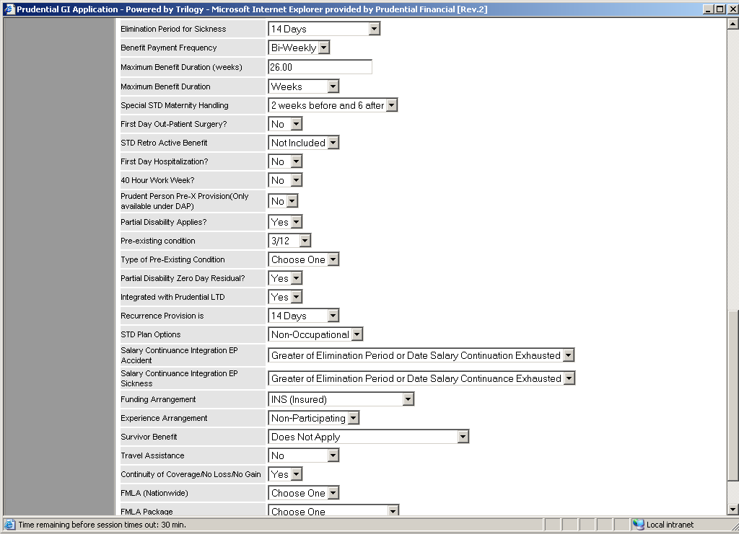
STD Plan Design 2
Elimination Period Accident: this is the amount of time an employee must be out of work due to an accident before they start receiving STD payments
Maximum Benefit Duration: This is the maximum amount of time Prudential will pay STD benefits. This passes to Standard Register
Prudent Person pre ex: Indicates that we will not cover a sickness if you fail to seek treatment for an illness or injury that a normal person would seek treatment for. Standard Register
Partial Disability: This field indicates if we will pay partial benefits if you are less than completely disabled. There is also a 2nd field partial disability 0 day residual. Which indicates that if you attempt to return to work but cannot we will not force you to repeat the elimination period (Both Go to Standard Register)
Survivor Benefit and Accelerated Survivor benefit: Pays a benefit to your family if you die while on STD disability. Standard Register
Pre Existing condition: Indicates if Prudential will exclude disability payment for pre existing conditions. Passes to Standard Register as Yes (Any Value other than None) and No (Value = None)

Slide 35
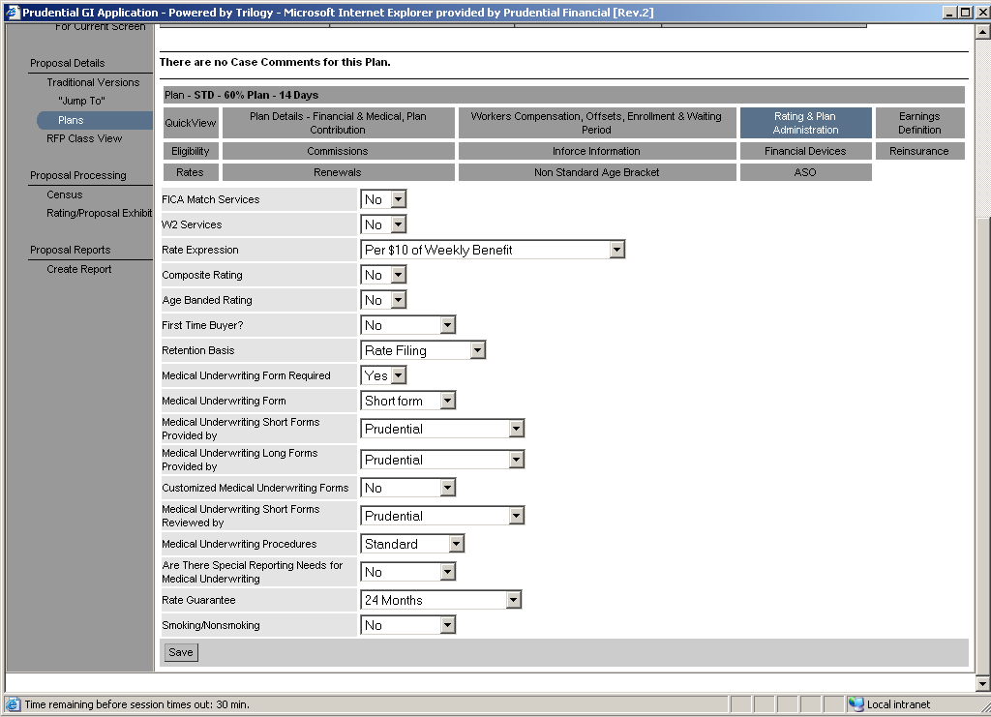
STD Rating & Plan Admin
Rate Expression: This field indicates what the rate will be multiplied by to determine the employee’s deduction. There are 2 basic kinds of rate expressions. Volume based and life based. Volume based rate take the amount of the employee benefit divides by the amount and multiplies by the rate. Life based rates charge a flat fee if the ee enrolls.
Age Banded Rating: The field indicates if rates vary based on age.

Slide 36
Long Term Disability
What is Long Term Disability (LTD)?
LTD is a disability product that pays the employee a benefit, usually a percentage of there earnings, if they become injured or sick and are out long enough.
LTD only has 1 benefit amount either a percentage of the employee’s earnings or a flat dollar amount.
LTD can be setup as contributory or non contributory or anything in between. Partially contributory plans are more common in the disability products
Most of the variables we will see affect Standard Register and do not impact the Web.
LTD rates are usually single flat rates but can be age banded. I have not seen smoker non smoker rates
The Main difference between STD and LTD is the length of time the disability is covered for. This leads to several additional benefits

Slide 37
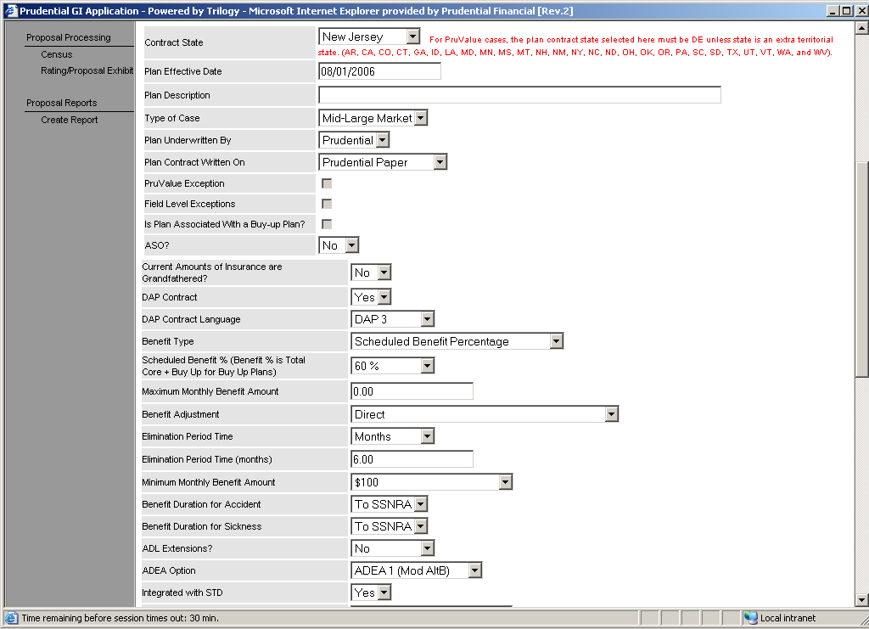
LTD Contract Type
Plan Type: This field indicates how the LTD benefit will be calculated either a Percentage of earnings or a flat amount. The flat amount is very rare for LTD
Maximum Dollar amount: After the weekly salary is multiplied by the benefit % we compare the benefit to the maximum and take the lesser of the 2 numbers
Scheduled Benefit %: this field is the number that will be multiplied by the Monthly salary and then paid out as a benefit
Elimination Period: this is the amount of time an employee must be out of work due to an accident before they start receiving LTD payments it is broken into 2 pieces 1 for accident and one for sickness. Passes to Standard register
Maximum Benefit Duration: This is the maximum amount of time Prudential will pay LTD benefits. This passes to Standard Register

Slide 38
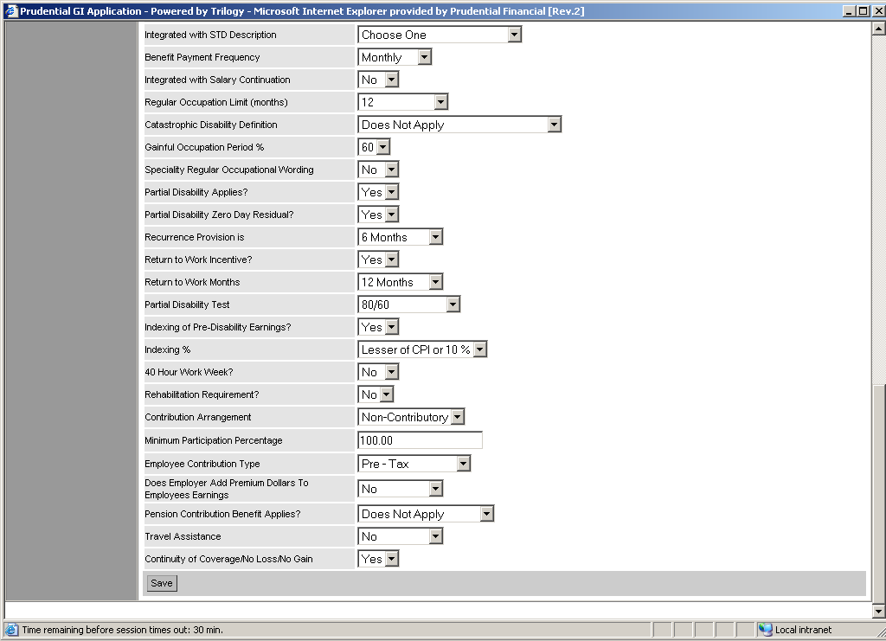
LTD Contract Type 2
Regular Occupation: This is the amount of time that Prudential will pay a benefit while an employee cannot work at there current job. After this time they have to be disabled enough to not work at a job appropriate for there education Standard Register)
Partial Disability: This field indicates if we will pay partial benefits if you are less than completely disabled. There is also a 2nd field partial disability 0 day residual. Which indicates that if you attempt to return to work but cannot we will not force you to repeat the elimination period (Both Go to Standard Register)
Return to Work Incentive: This is a benefit that pays money if the employee attempts to return to there job even on a part time basis
Contribution Arrangement: This field indicates if the employer or the employee will pay for the coverage. Contributory Means the Employee Pays. Non Contributory means the employer pays

Slide 39
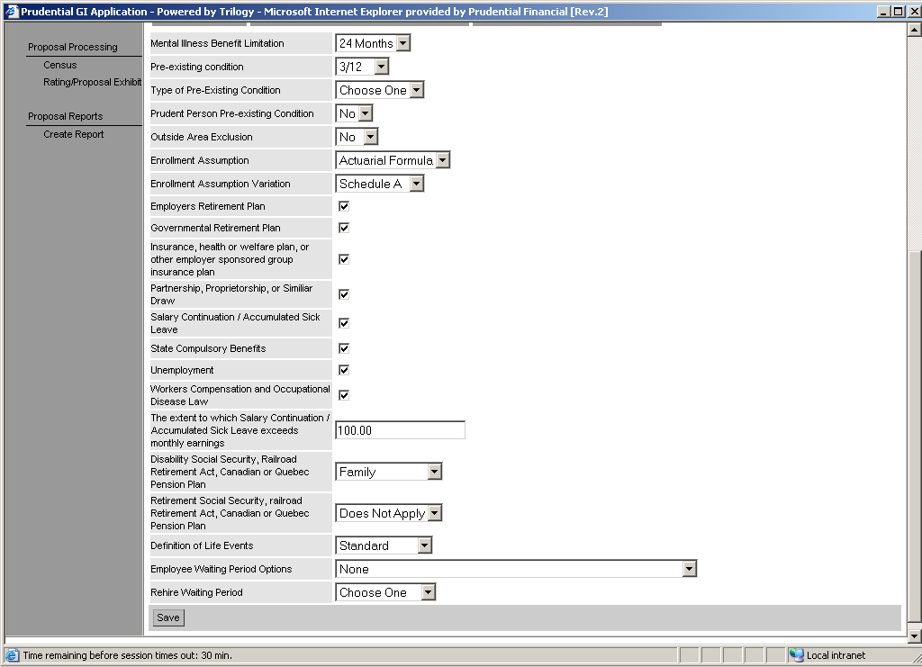
LTD Exclusions
Mental Illness Benefit Limitation: Indicates the maximum amount of time Prudential will pay for a disability due to mental illness includes alcohol/drugs. Standard Register
Pre Existing condition: Indicates if Prudential will exclude disability payment for pre existing conditions. Passes to Standard Register as Yes (Any Value other than None) and No (Value = None)
Prudent Person pre ex: Indicates that we will not cover a sickness if you fail to seek treatment for an illness or injury that a normal person would seek treatment for. Standard Register
Partial Disability: This field indicates if we will pay partial benefits if you are less than completely disabled. There is also a 2nd field partial disability 0 day residual. Which indicates that if you attempt to return to work but cannot we will not force you to repeat the elimination period (Both Go to Standard Register)

Slide 40
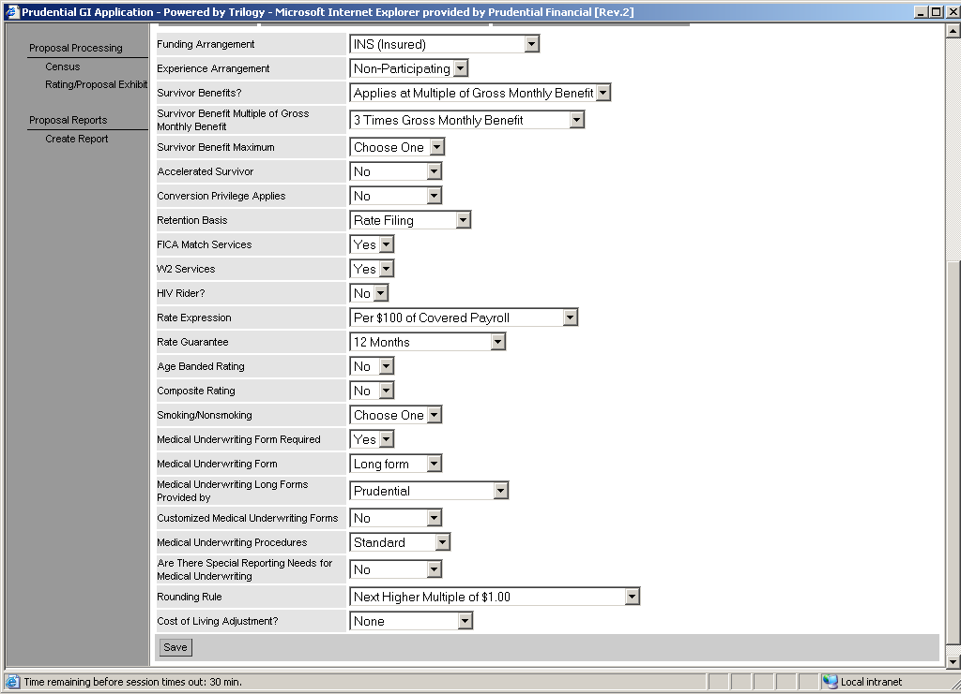
LTD Financial Arrangements
Survivor Benefit and Accelerated Survivor benefit: Pays a benefit to your family if you die while on STD disability. Standard Register
Rate Expression:LTD’s rate expression selection is fundamentally different than any other products. LTD is priced on a covered payroll basis. To calculate covered payroll take monthly salary multiply by the benefit % cap at the maximum dollar amount then divide by the benefit %. The shorthand way is to just us e the monthly salary
Age Banded Rating: The field indicates if rates vary based on age.

Slide 41
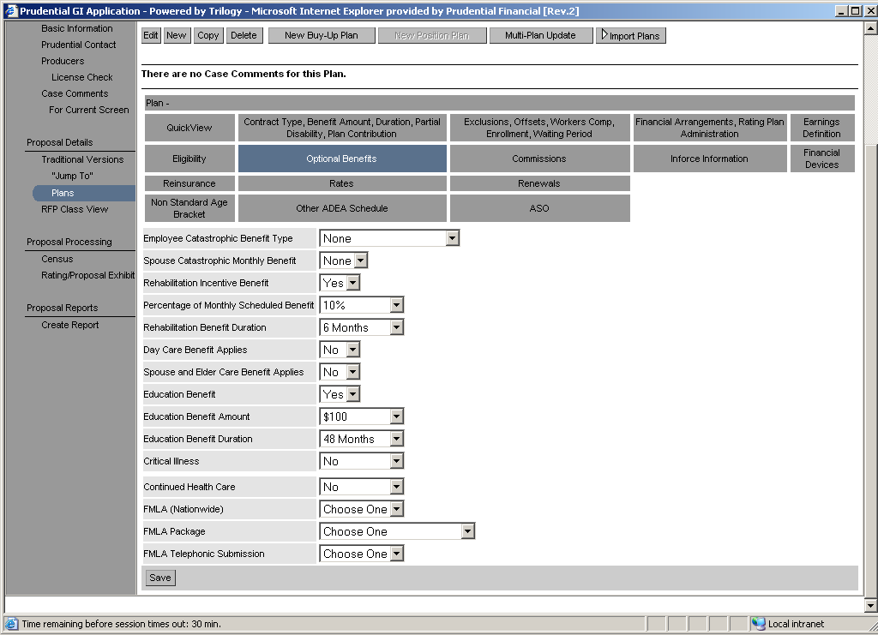
LTD Additional Benefits
Employee Catastophic benefit: Pays the employee and additional benefit if they cannot perform 2 activities of daily life. (ex. Bathing, feeding yourself) Standard Register
Spouse Catastophic benefit: Pays the employee if there spouse if they cannot perform 2 activities of daily life. (ex. Bathing, feeding yourself) Standard Register
Rehab incentive benefit: Pays an additional benefit if the employee attends rehab for there injuries/sickness. Standard Register
Education Benefit: Pays a benefit to help with your dependent’s college expenses while you are on disability Standard Register
Critical Illness: Provides an additional benefit when the employee is disabled with certain illnesses. Ex Heart Attack, Cancer, Transplant, Stroke, Renal Failure, Standard Register
Continued Healthcare. Pays healthcare premiums while you are on disability Standard Register

Slide 42
GUL/GVUL
What is GUL/GVUL?
GUL and GVUL are very similar to Optional life.
They are both Contributory coverages that have plan designs that allow multiple options
From a business perspective the difference between GUL/GVUL and Optional Life is that GUL and GVUL have an investment portion that can gain value. GUL Pays a certain percentage like a money market. GVUL has mutual funds attached to it
GUL and GVUL are typically sold to very large companies (10,000+ lives)
While the basic plans are similar to Optional life GUL and GVUL offer some different challenges since they are not core SPARC products

Slide 43
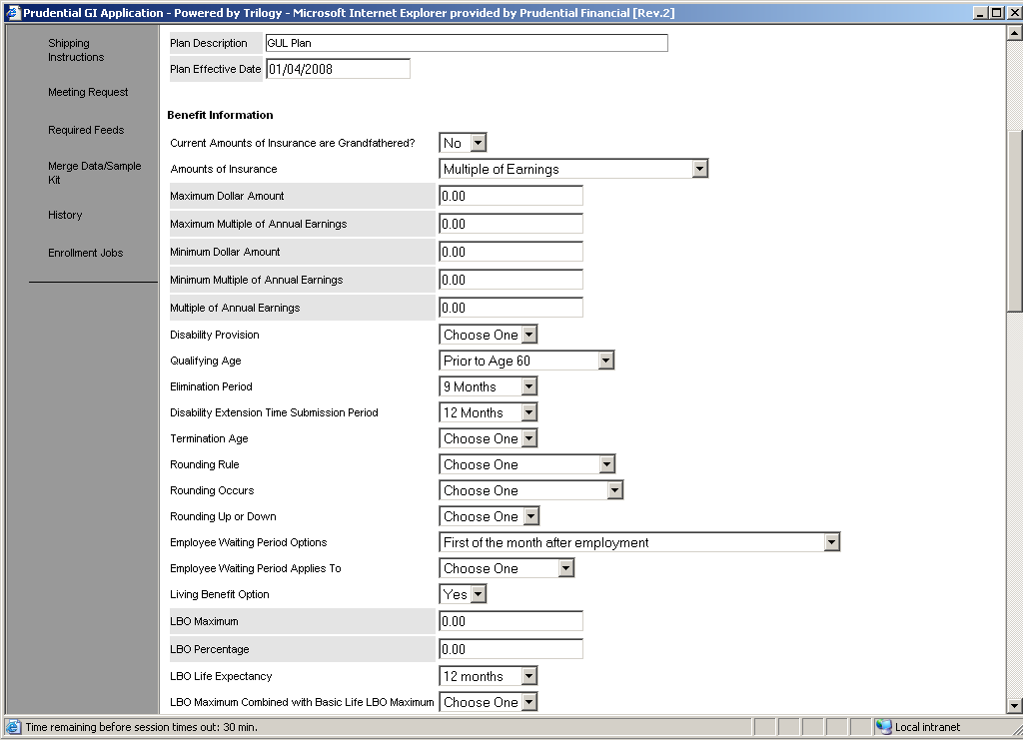
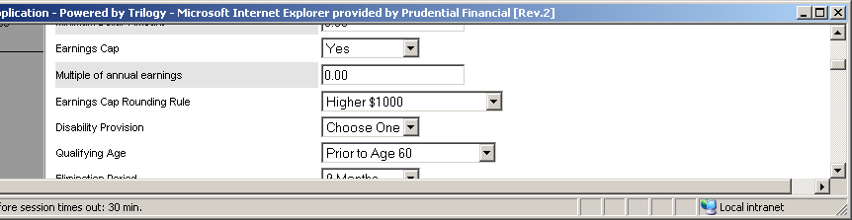
GUL/GVUL Plan Design 1
The Amounts of insurance field controls how the employee’s insurance will be calculated. There are 2 basic types Multiple of Earnings where the salary is multiplied by the annual Salary, and flat amounts where employees are insured for a specific dollar amount. In optional Products the amounts of insurance allows the employee to choose there amount.
Earnings Cap Rounding Rule: This field works much like the rounding rule but, it rounds after the salary has been multiplied by the earnings cap multiple
Earnings Cap: This field restricts the Maximum benefit for the employee on Incremental flat plans. In addition to the incremental max the salary is also multiplied by the multiple. The final max is the lesser of the multiple and the incremental max

Slide 44
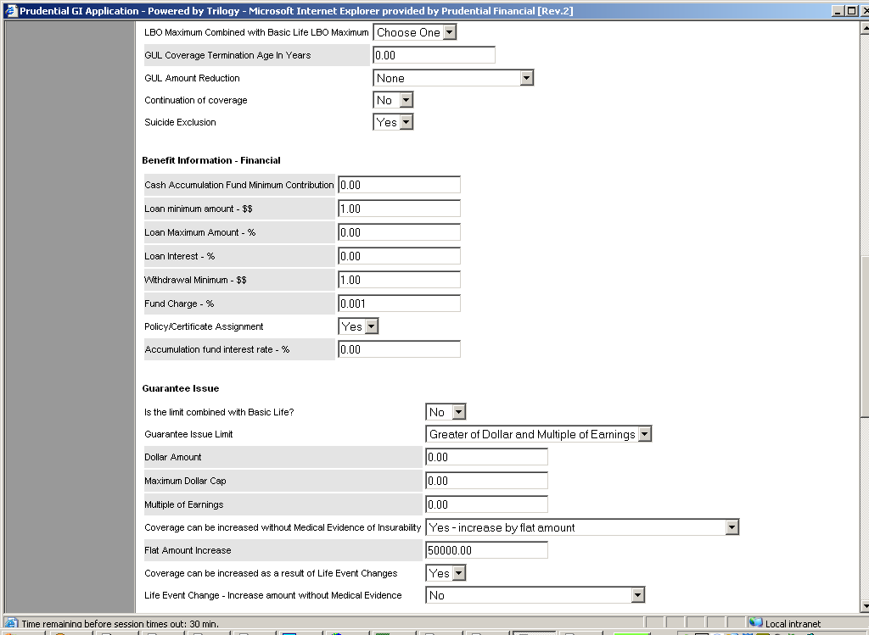
GUL/GVUL Plan Design 2
GUL Termination Age in Years: This field indicates the maximum age that someone can be and still purchase GUL coverage.
Is there an Annual Enrollment without medical evidence: This field controls a portion of the Guarantee issue limit called the Bump. The Bump allows employees with current coverage to increase there Coverage. Bumps allow you to go up by coverage amounts not dollars, the best way to imagine how the bump allow an employee to increase coverage is to write all of the amounts the employee can get down then write there current coverage down and count up by the number of increments specified
Is the Limit Combined with Basic Life: This field indicates that the Guarantee issue limit includes the basic life amount. So whatever basic life coverage the employee has is subtracted from the GUL GI
Guarantee Issue Limit: The Guarantee issue limit defines the maximum amount of insurance an employee can purchase without proving they are in good health. The Guarantee issue limit can be defined as a dollar amount, a multiple of earnings or both
Bump Maximum Field: This field defines the maximum amount the bump can increase the employee’s coverage. There are 2 choices lesser of bump and GI which will allow the user to increase to the lesser of the bump amount and the guarantee issue. Lesser of Bump and Flat Dollar which will allow the user to increase to the bump or a flat dollar amount even if it exceeds the Guarantee issue

Slide 45
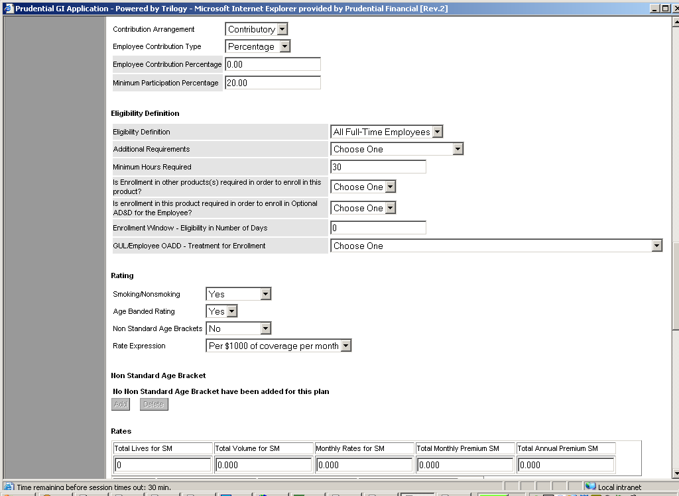
GUL/GVUL Plan Design 3
Smoking/Non Smoking: Indicates if rates vary based on whether they smoke or not. This only applies to mid/large market cases.
Contribution Arrangement: This field indicates if the employer or the employee will pay for the coverage. Contributory Means the Employee Pays. Non Contributory means the employer pays
Is Enrollment in this product required in order to in Optional ADD for the Employee and Is enrollment in other products required to enroll in this product: Both of these fields will be replaced by the new dependency functionality
Rate Expression: This field indicates what the rate will be multiplied by to determine the employee’s deduction. There are 2 basic kinds of rate expressions. Volume based and life based. Volume based rate take the amount of the employee benefit divides by the amount and multiplies by the rate. Life based rates charge a flat fee if the ee enrolls.
Age Banded Rating: The field indicates if rates vary based on age.
Non Standard Age banding: This indicates that age bands are customized. It only appears when age banding = Yes. Will also not appear if the case is small market Setting this field to Yes will enable the Non Standard age bracket tab where users can define any age bands they want ex. 0-20, 20-25. This will determine the age bands the rates are captured in

Slide 46
Critical Illness
What is Critical Illness?
Provides money when the employee has a serious covered illness
Critical illness can be setup as a basic or optional product

Slide 47
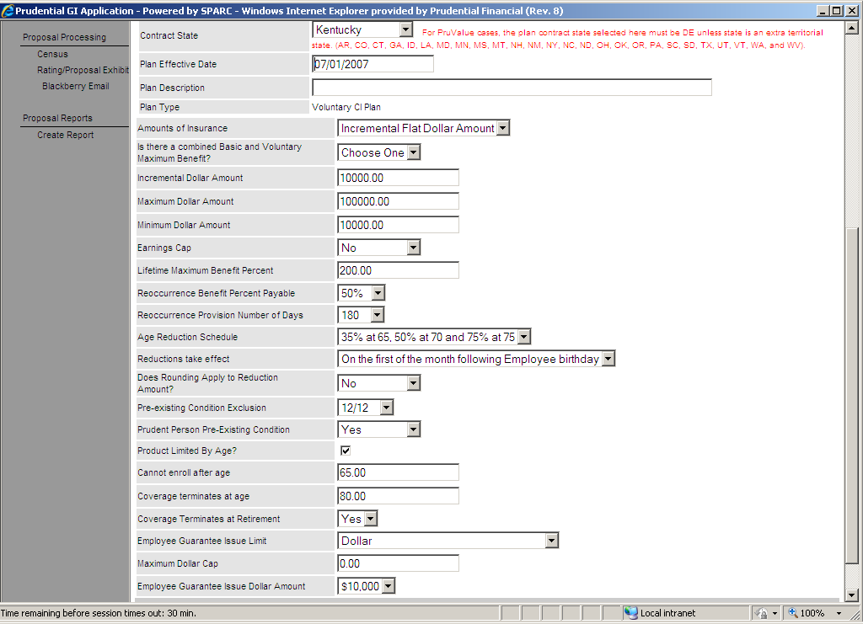
Critical Illness Plan Design 1

Slide 48
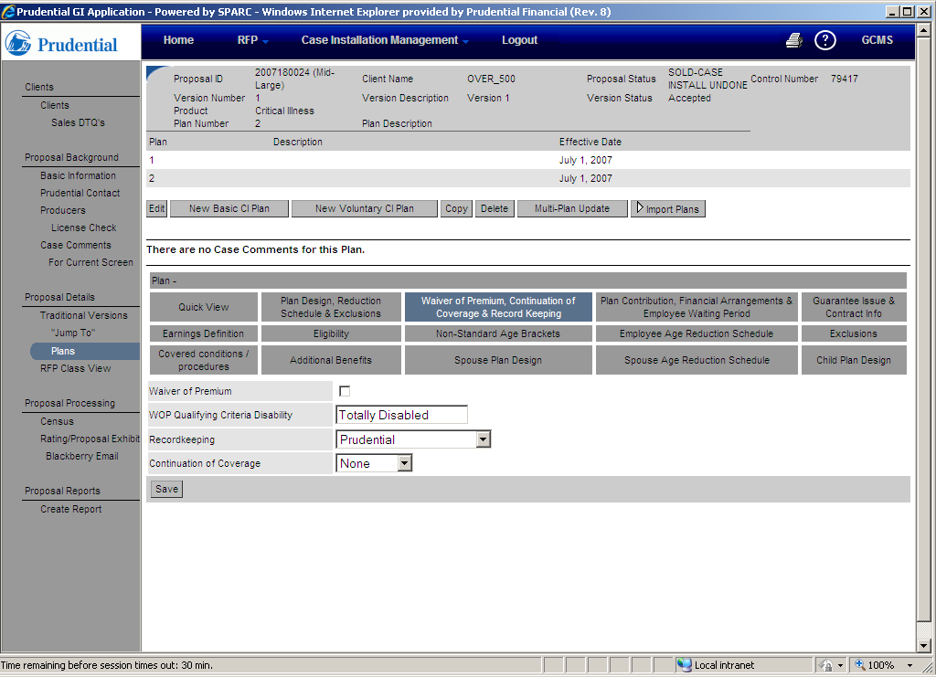
Critical Illness Plan Design 2

Slide 49
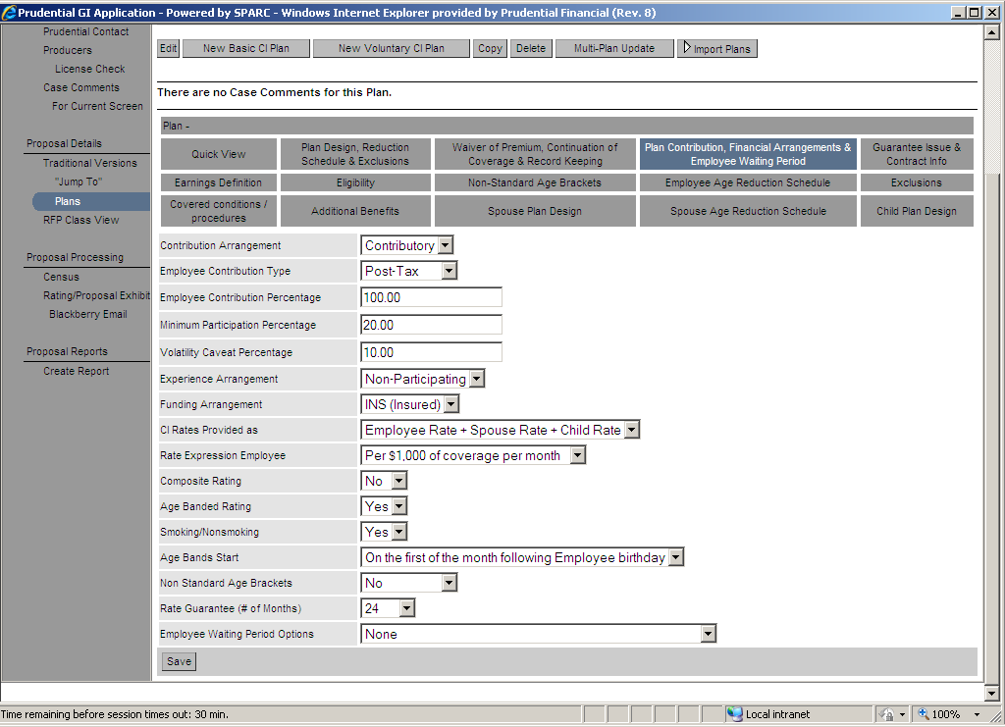
Critical Illness Plan Design 3

Slide 50
Critical Illness Plan Design 3

Slide 51
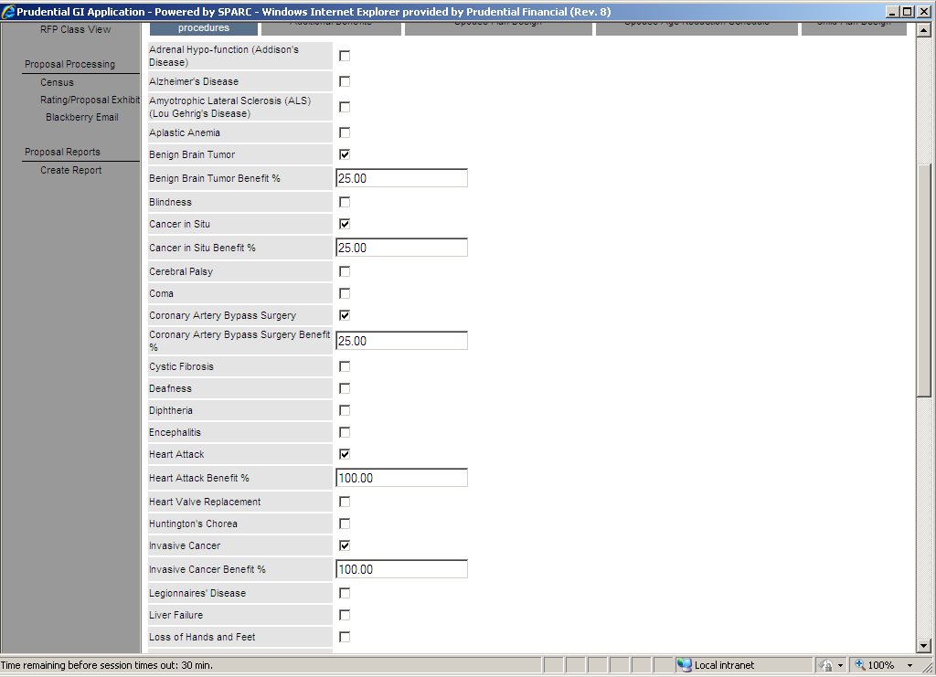
Critical Illness Plan Design 4

Slide 52
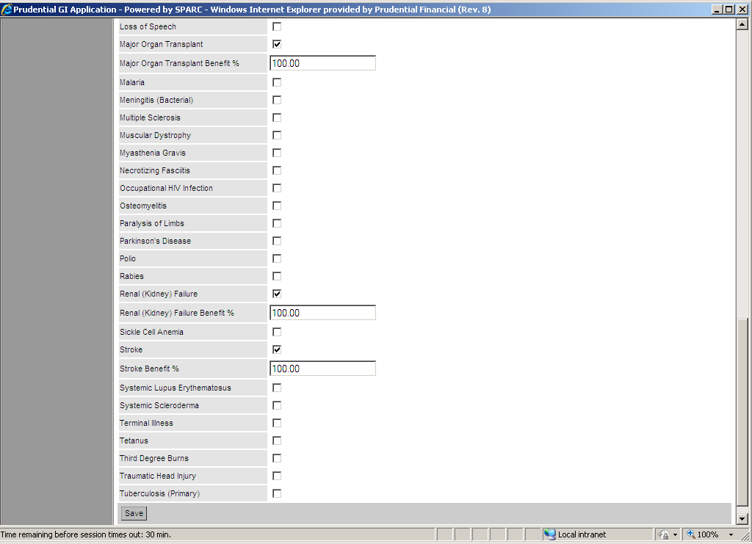
Critical Illness Plan Design 5

Slide 53
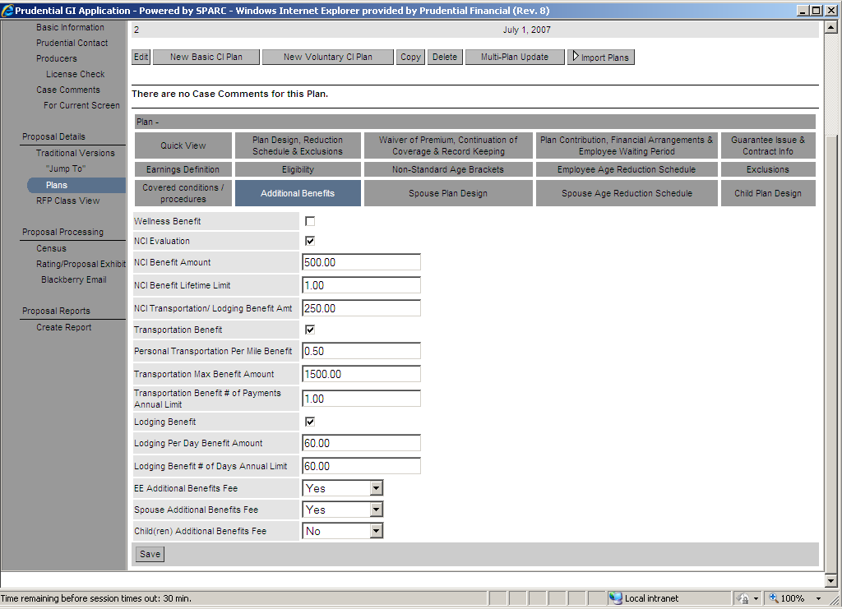
Critical Illness Plan Design 6

Slide 54
Critical Illness Plan Design 6

Slide 55
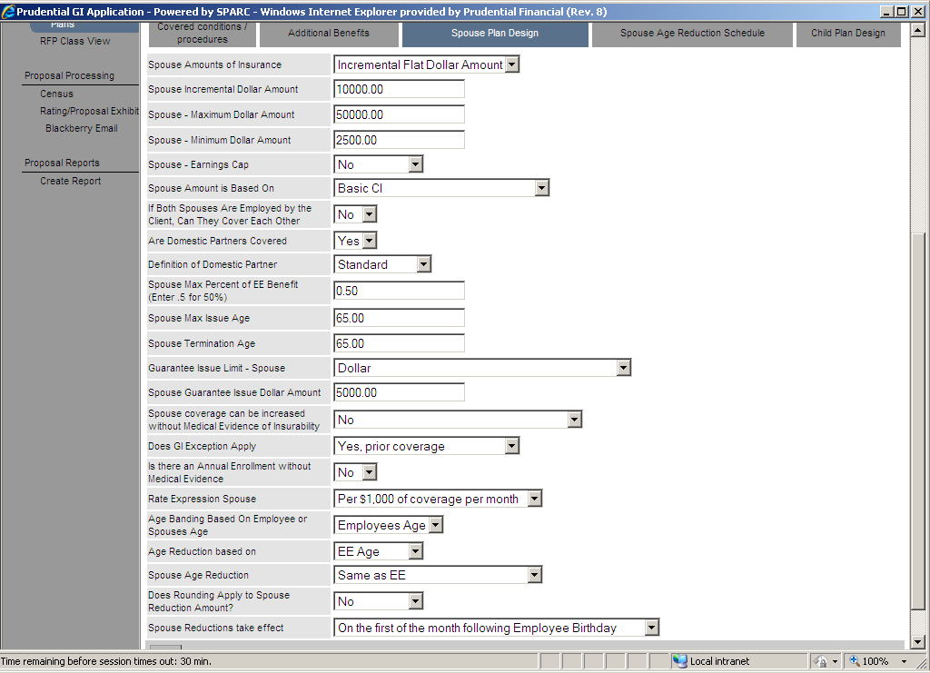
Critical Illness Plan Design 6

Slide 56
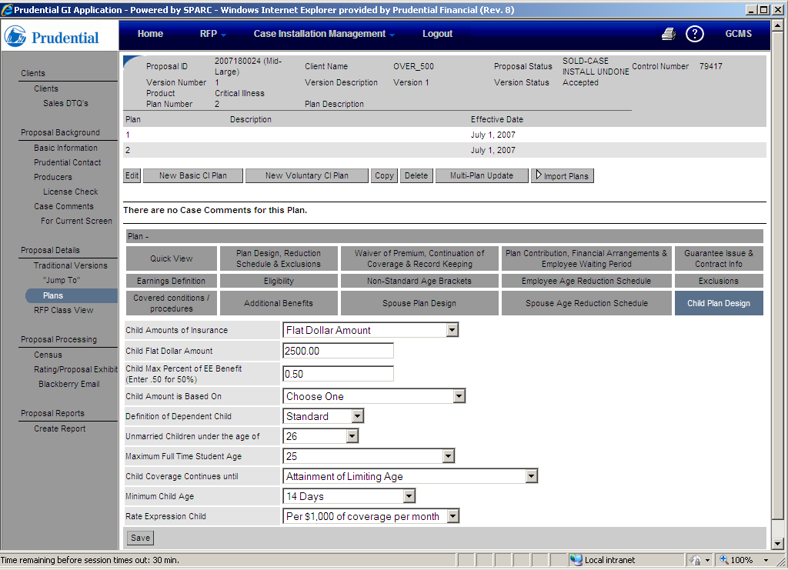
Critical Illness Plan Design 6

